Slide 1
SOFTWARE ENGINEERING (DAY 1-2)
SUMMER INTERNSHIP BY VIRTUSA
BY:
Divya Pratap Singh
11705218
Lovely Professional University

Slide 2
INDEX
Introduction to Software Engineering
SDLC Phases
SDLAC-Models
Waterfall Model
V-model
Iterative, Incremental Model
Spiral Model
Overview of Agile Model and Agile

Slide 3
Introduction
SDLC is a process followed for a software project, within a software organization.
It consists of a detailed plan describing how to develop, maintain, replace and alter or enhance specific software.
The life cycle defines a methodology for improving the quality of software and the overall development process.

Slide 4

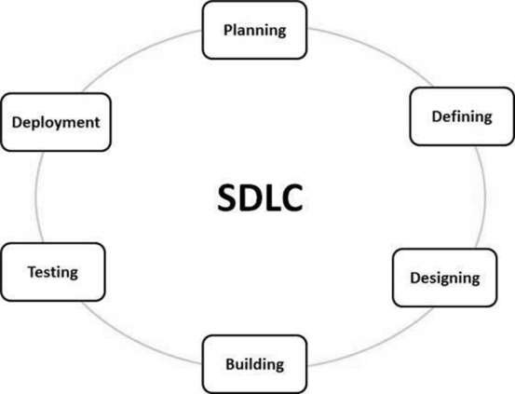


Slide 5
Phases Of SDLC
Stage 1: Planning and Requirement Analysis :- Planning for the quality assurance requirements and recognization of the risks involved is also done at this stage.
Phase 2: Feasibility study:- This process conducted with the help of 'Software Requirement Specification' document also known as 'SRS' document.

Slide 6
Stage 3: Designing the Product Architecture:- the system and software design documents are prepared as per the requirement specification document. This helps define overall system architecture.
Stage 4: Building or Developing the Product:- In this stage of SDLC the actual development starts and the product is built. The programming code is generated as per DDS during this stage. If the design is performed in a detailed and organized manner, code generation can be accomplished without much hassle.

Slide 7
Stage 5: Testing the Product:- The testing team starts testing the functionality of the entire system. This is done to verify that the entire application works according to the customer requirement.
Stage 6: Deployment in the Market and Maintenance :- Based on the feedback given by the project manager, the final software is released and checked for deployment issues if any.

Slide 8
WATERFALL MODEL
The waterfall is a widely accepted SDLC model. In this approach, the whole process of the software development is divided into various phases. In this SDLC model, the outcome of one phase acts as the input for the next phase.
This SDLC model is documentation-intensive, with earlier phases documenting what need be performed in the subsequent phases.

Slide 9
Incremental Approach
The incremental model is not a separate model. It is essentially a series of waterfall cycles. The requirements are divided into groups at the start of the project. For each group, the SDLC model is followed to develop software.
The SDLC process is repeated, with each release adding more functionality until all requirements are met. In this method, every cycle act as the maintenance phase for the previous software release. Modification to the incremental model allows development cycles to overlap. After that subsequent cycle may begin before the previous cycle is complete.

Slide 10
V-Model
In this type of SDLC model testing and the development, the phase is planned in parallel. So, there are verification phases on the side and the validation phase on the other side. V-Model joins by Coding phase.

Slide 11
Spiral Model
The spiral model is a risk-driven process model. This SDLC model helps the team to adopt elements of one or more process models like a waterfall, incremental, waterfall, etc.
This model adopts the best features of the prototyping model and the waterfall model. The spiral methodology is a combination of rapid prototyping and concurrency in design and development activities.

Slide 12
Agile Model
Agile methodology is a practice which promotes continue interaction of development and testing during the SDLC process of any project. In the Agile method, the entire project is divided into small incremental builds. All of these builds are provided in iterations, and each iteration lasts from one to three weeks.

Slide 13
CONCLUSION
The SDLC is a systematic process for building software that ensures the quality and correctness of the software built
The full form SDLC is Software Development Lifecycle.
SDLC process provides a framework for a standard set of activities and deliverables
Seven different SDLC stages are 1) Requirement collection and analysis 2) Feasibility study: 3) Design 4) Coding 5) Testing: 6) Installation/Deployment and 7) Maintenance
The senior team members conduct the requirement analysis phase
Feasibility Study stage includes everything which should be designed and developed during the project life cycle
In the Design phase, the system and software design documents are prepared as per the requirement specification document

Slide 14
CONCLUSION
In the coding phase, developers start build the entire system by writing code using the chosen programming language
Testing is the next phase which is conducted to verify that the entire application works according to the customer requirement.
Installation and deployment face begins when the software testing phase is over, and no bugs or errors left in the system
Bug fixing, upgrade, and engagement actions covered in the maintenance face
Waterfall, Incremental, Agile, V model, Spiral, Big Bang are some of the popular SDLC models
SDLC consists of a detailed plan which explains how to plan, build, and maintain specific software

